Slide 1
Git
An Introduction
Axel Goblet
Roy Mengelers

Slide 2
Content
What is Git?
Setting up Git
Making Changes
Branching
Merging

Slide 3
What is Git?
Version control system
Emphasis on efficiency
Team members can work in parallel

Slide 4
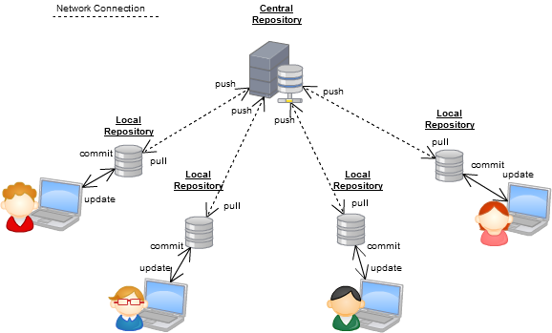
What is Git?
V1.1
V1.0
V1.0
V1.0
V1.0
V1.0
V1.1
V1.1

Slide 5
Setting up Git
Install Git (https://git-scm.com/download)
Install Git Bash (command line) or SourceTree (GUI, https://www.sourcetreeapp.com/)
Create a repository (using GitHub)
Clone the repository

Slide 6
Demo

Slide 7
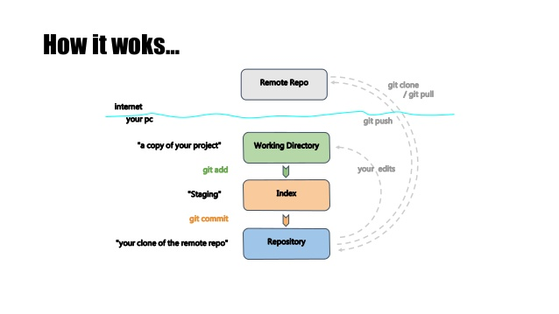
Making Changes

Slide 8
Making Changes
Changes are made within your personal workspace
Stage changes you want to commit
Commit the staged changes
Push the committed changes to the central repository
Always pull changes from the central repository before starting your work or commiting

Slide 9
Making Changes
Stage changes → git add <path>
Stage all changes → git add -A
Commit changes → git commit
Push changes → git push
Update local repository → git pull
View current status → git status
Checkout repository → git checkout <path>
Or just use a tool like SourceTree ☺

Slide 10
Demo Case “Hello World”

Slide 11
Branching
Work on multiple features simultaneously
Create a separate copy of the repository

Slide 12
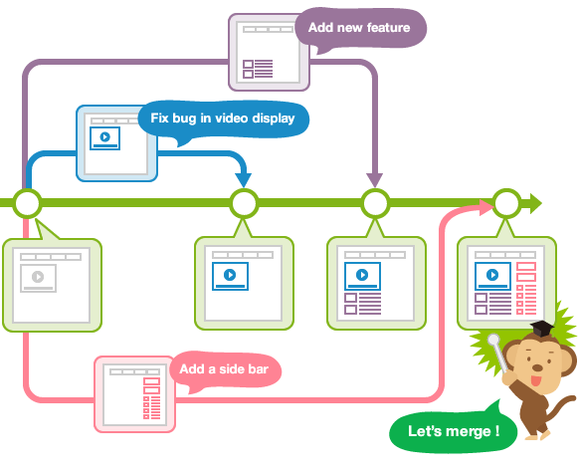
Branching

Slide 13
Branching
Create a branch → git branch <name>
Checkout a branch → git checkout <name>
Push a new branch → git push --set-upstream origin <name>
Delete local branch → git branch –D <name>
Delete remote branch → git push origin :<name>

Slide 14
Demo Case “Hello Mad World”

Slide 15
Merging
Merge another repository into your current one
Changes to the same file are merged automatically
Merge conflicts appear if the auto-merging is not possible

Slide 16
Merging

Slide 17
Solving Merge Conflicts
Resolve the conflict
Commit

Slide 18
Demo

Slide 19
How to prevent all this?
Frequently merge the master branch into your branch
Always pull your branch before starting to work on it
Team coordination

Slide 20
Summary

Slide 21
Thank you for your attention

